Slide 1
Teaching Elementary Students to Solder
By Deanna Schmalz and Brian Schmalz
Notes:
Hai, I am deanna And I am 11 years old and go to glen lake elementary school.
I will tell you about how I designed a learn to solder board to teach my friends at school how to solder a circuit board.

Slide 2
Why I did this
I wanted to introduce soldering to my classmates in school
My Dad is an engineer, and he taught me to solder, and I found it fun
I love soldering kits together
I wanted my friends to learn how to solder so they could join in on the fun!
Notes:
I like to solder because it is fun and I like the product the end
I learned to solder at about 4.5 years old and like to solder useful and fun kits
I wanted to teach my friends so they could have fun with me
also teacher, Mr. B, thought it would be a good STEM activity for all of the 4th graders to learn how to solder.
STEM stands for Science,Technology, Engineering, and Math.

Slide 3
What I did
When I was a 4th grader, I designed my first board: Blinking Grapes
Notes:
I designed my first board to see if I could do it, not just make other people's ideas.
I made 3
I showed it to my class
they liked it

Slide 4
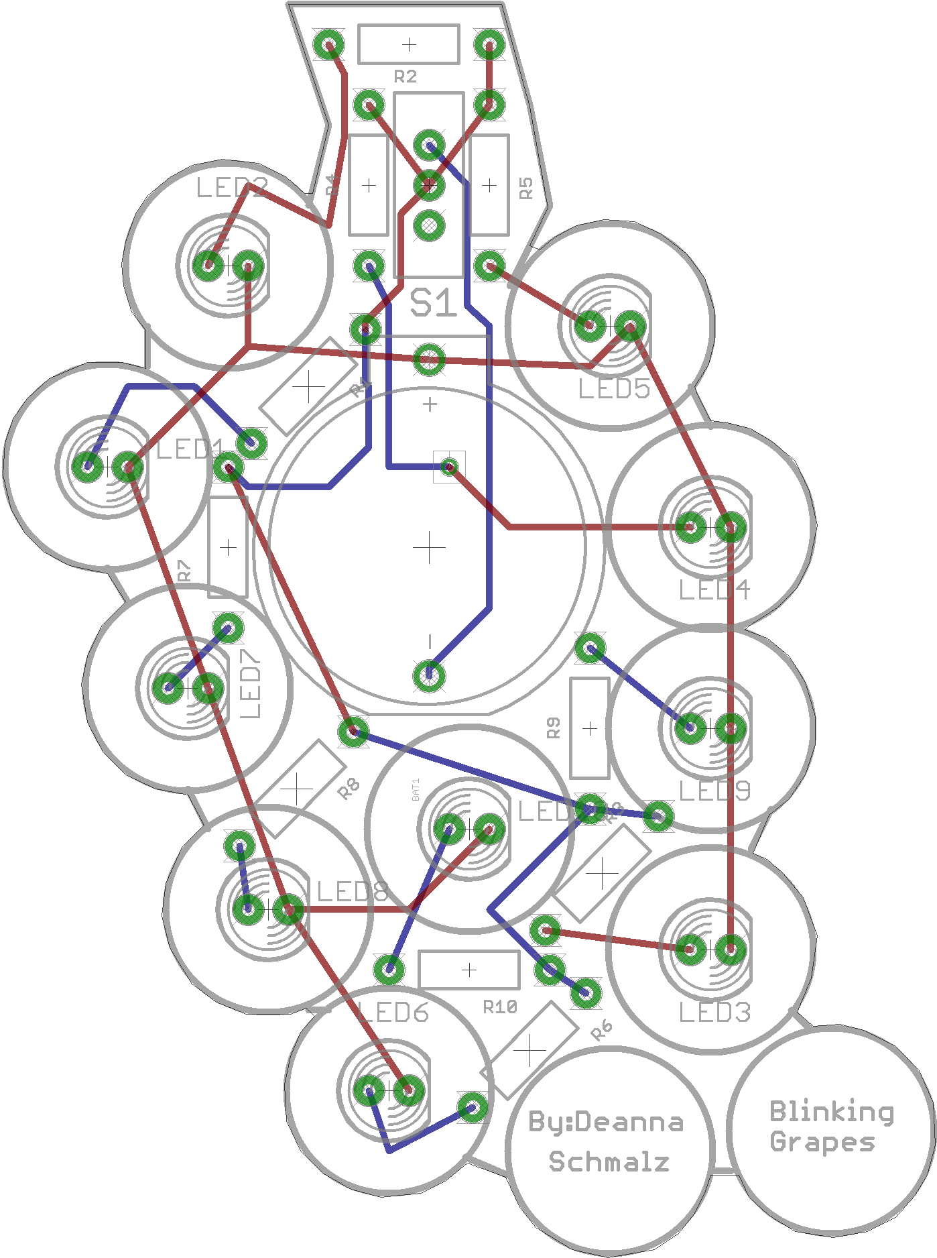
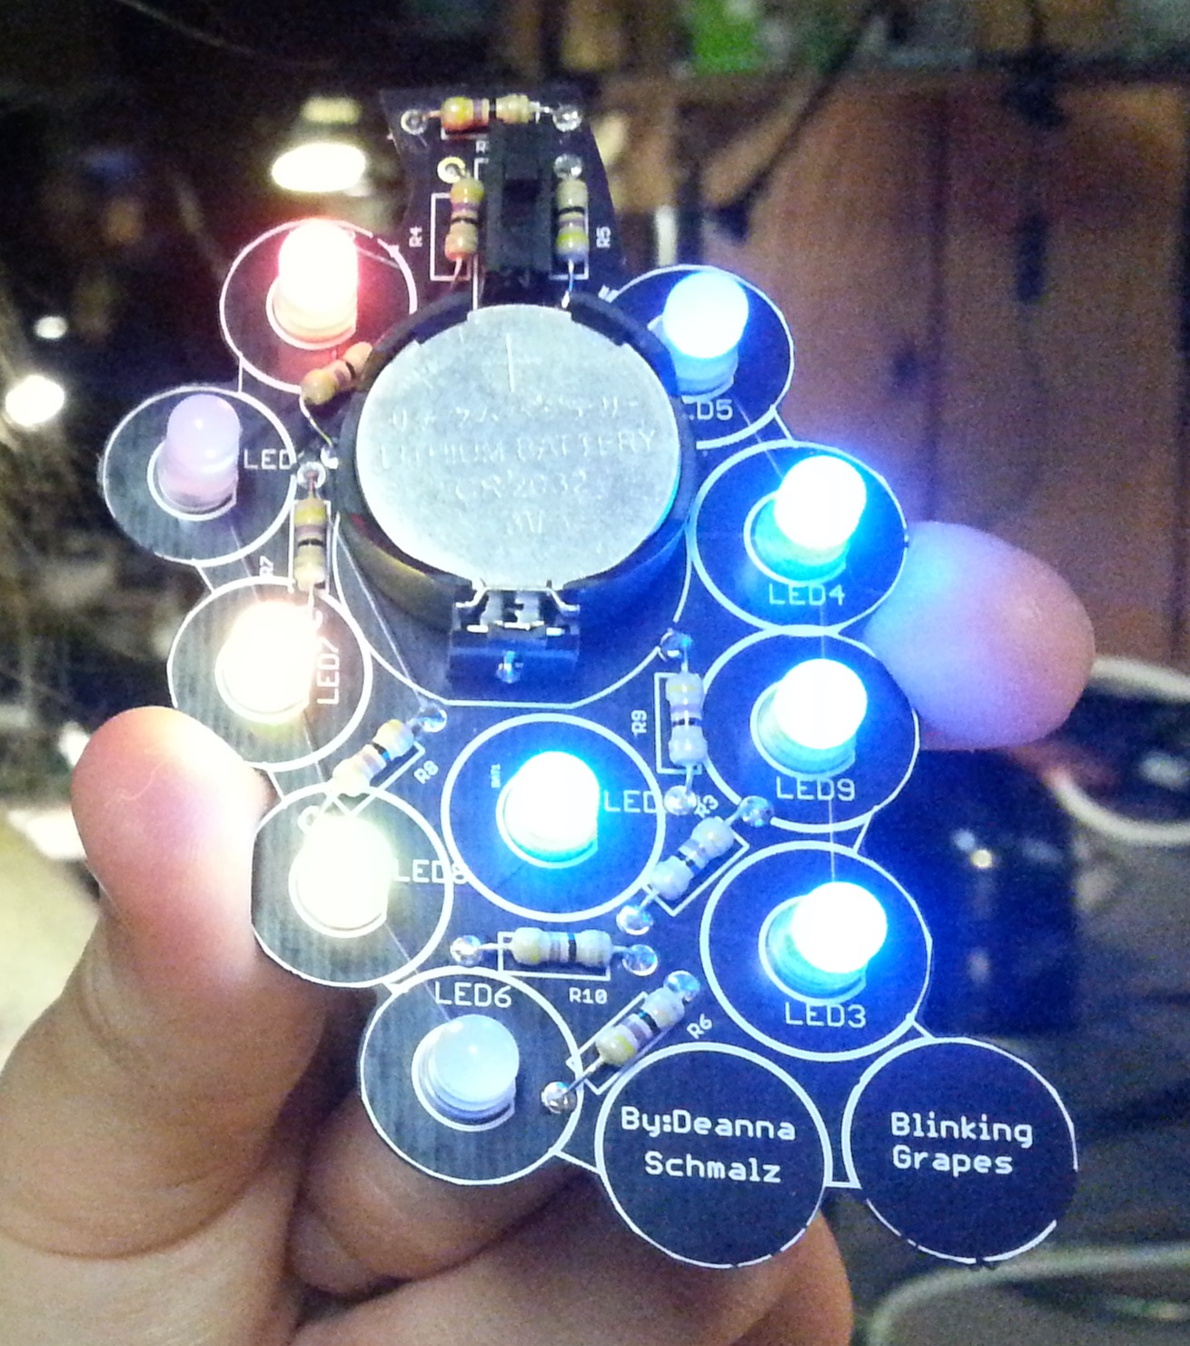
Blinking Grapes Board
Notes:
This is blinking grapes, it has LEDs, resistors, a battery, and a Switch.

Slide 5
What I did
Now I’m in 5th grade, and designed a board to teach my friends how to solder
My school does a 4th grade STEM day
We used my learn-to-solder board to teach the 4th graders to solder
Notes:
I go to glen lake elementary , a STEM focus school
they have a STEM day every year to teach engineering

Slide 6
Learn-to-solder Board Design
Needed to be simple, few parts, easy through hole soldering
Shape: “H” for Hopinks School District
Silk screen: “4” for 4th grade, “Paws” for “Glen Lake Paws Pride”
Blinking LEDs (blue/white for Hopkins colors)
Paws=Perform your best,Act in a caring way,Work and play safely,Show respect and responsibility
Notes:
I wanted it to be simple but teach the basics
in the shape of an h for hopkins school district
Only some parts to keep it simple and not timely
only through hole because it is easier to solderer, especially for beginners
Cheap boards because the PTO gave us $1.50 for each kit
I put Hopkins learn to solder, by deanna, and PAWS on the silkscreen layer

Slide 7
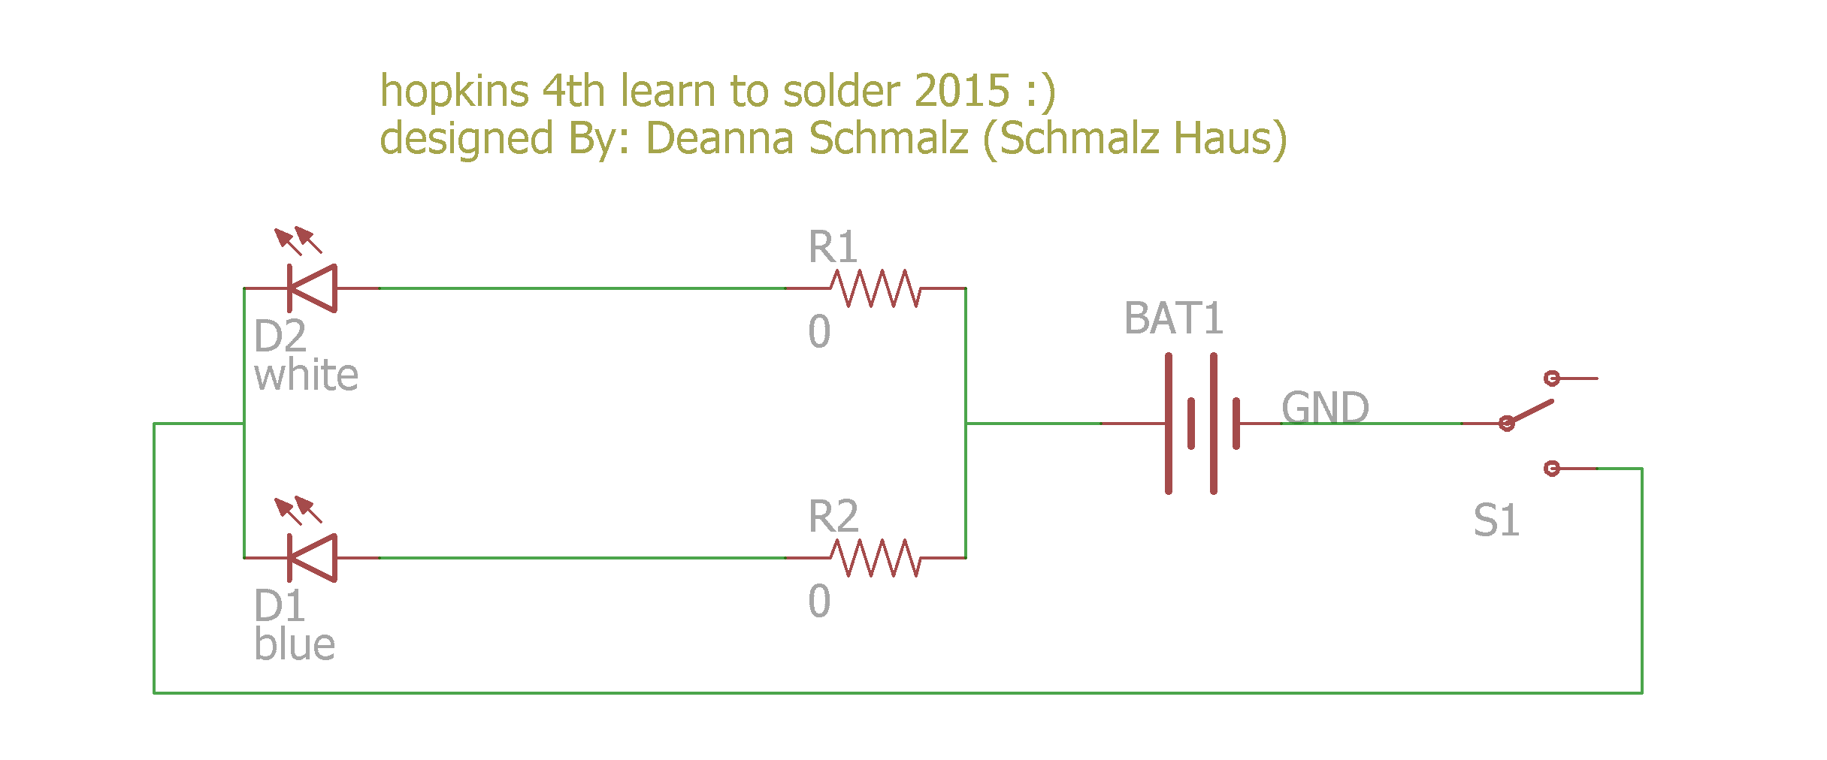
Learn-To-Solder : Schematic
Notes:
To make this schematic I Added the parts and connected the wires to make it work

Slide 8
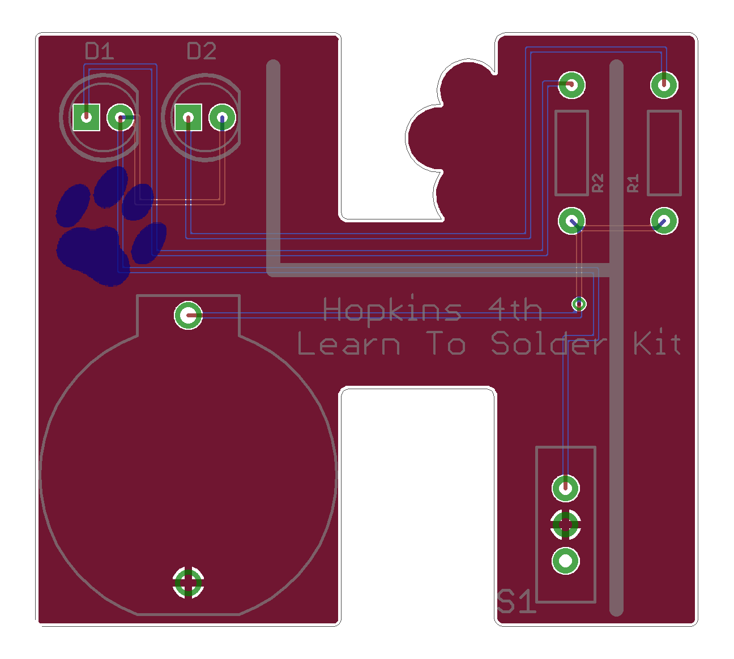
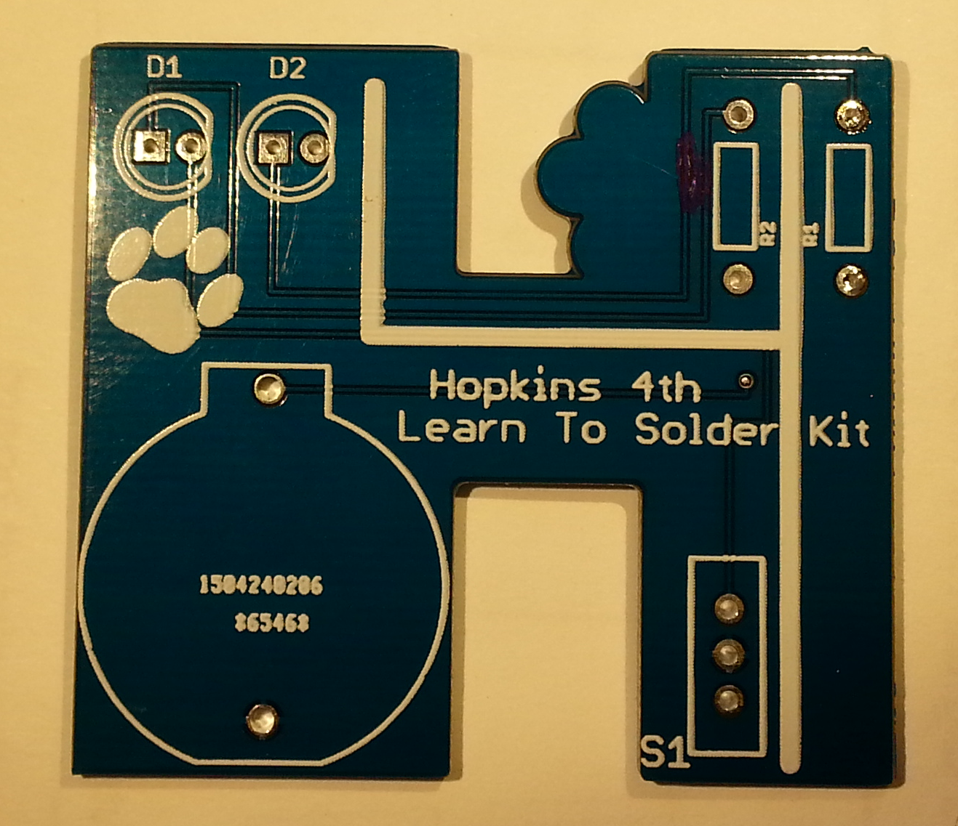
Learn-To-Solder: Board Layout
Notes:
I routed the board in eagle
added silkscreen paws

Slide 9
How I designed the board
Used Eagle: drew schematic with battery, switch, resistors, and LEDs
Created board outline in “H” shape
Routed the board
Added features in silk screen
Had 10 prototypes made of ver 0.5
Tweaked it, to make version 1.0
Notes:
first board version worked perfectly, but didn’t have all of the features I wanted
added more paws and made the outline match the paws
made the through holes easier for kids to solder by making them wider

Slide 10
Packaged 100 Kits
Ordered 100 boards from DirtyPCB
Ordered 100 sets of parts from e-bay
Kitted up 100 kits worth of parts and boards in plastic bags
Notes:
Ordered 100 boards from dirtyPCBs
Waited
We put 100 parts and boards into 100 bags

Slide 11
Preparing For STEM Day
We taught Mr. B (4th grade teacher) to solder, got feedback on instructions
Re-did instructions : made simpler, almost all hand-drawn pictures
Got 12 sets of soldering irons, tools, desk lights, safety glasses, etc.
Notes:
Had to make easy instructions follow
got people to loan us tools
bought supplies, solder, soldering irons
set everything up before hand to make sure it would work

Slide 12
STEM Day
Had 3 adults and me helped 12 students at a time to put together their kits (about 72 total)
Took about 20 minutes
My dad demonstrated how to solder a kit for all students to see at beginning
All students ended up with working kits
Notes:
we set up soldering stations at the desks
we had 2 engineer helpers, me, and my teacher helping the students solder
it was hard to get everything soldered in the 20 minutes that each group had

Slide 13
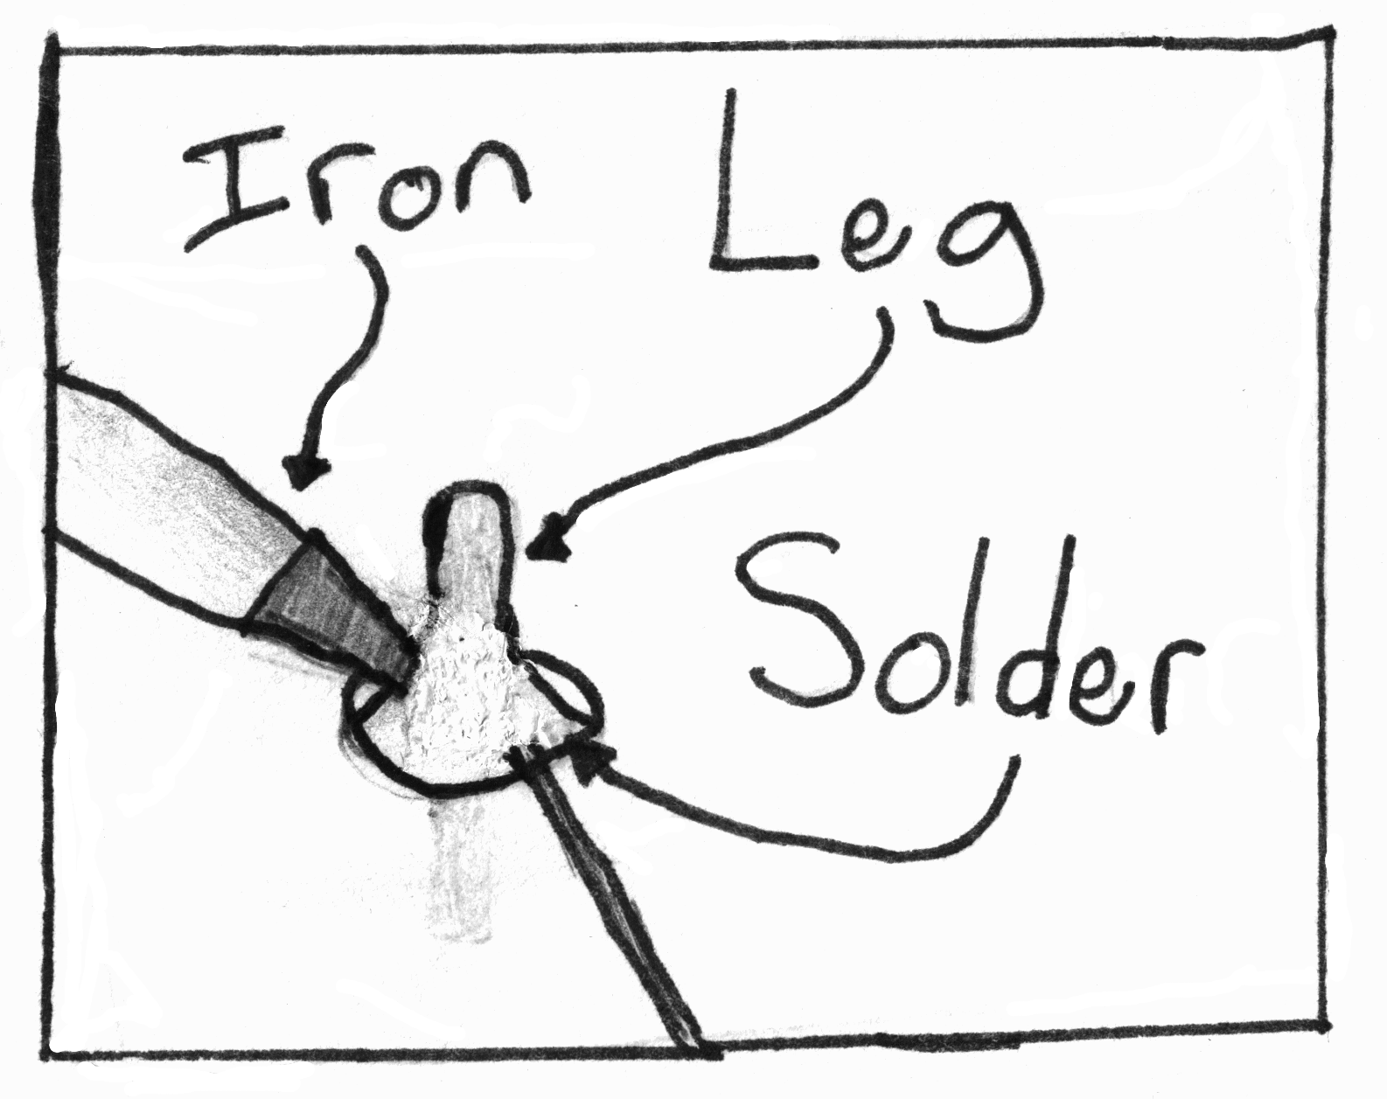
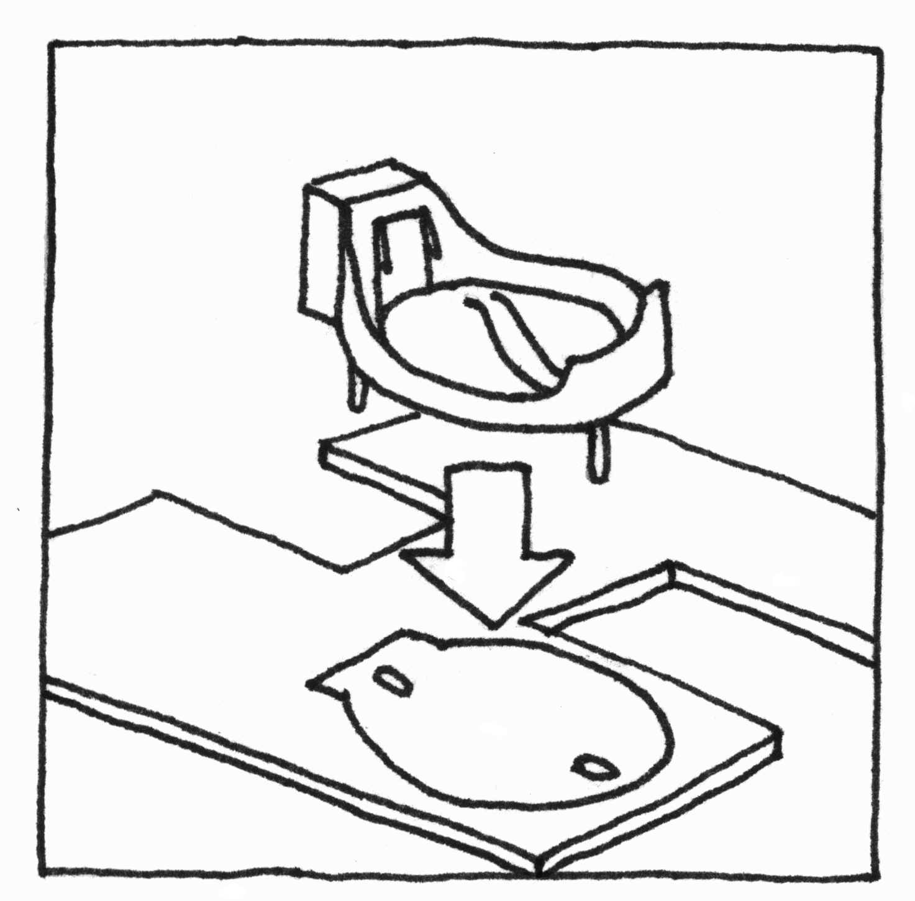
Instruction Sheet:
Notes:
I made a simple instruction sheet,with pictures of each tool and steps to assemble the kit,easy to understand
Most didn't pay attention to instructions, because I could help and they could figure it out

Slide 14
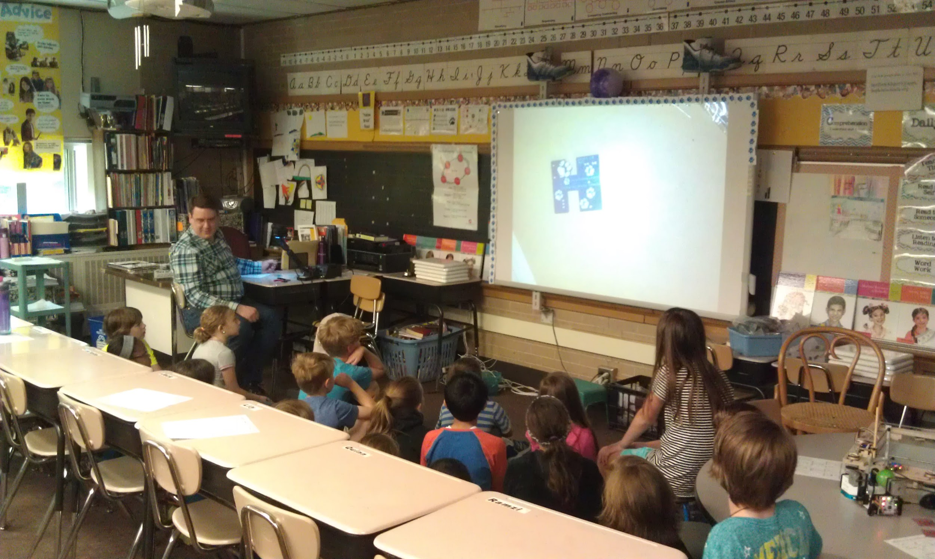
STEM Day!
Notes:
Here is my dad showing the class how to solder. He projected his soldering up on the screen

Slide 15
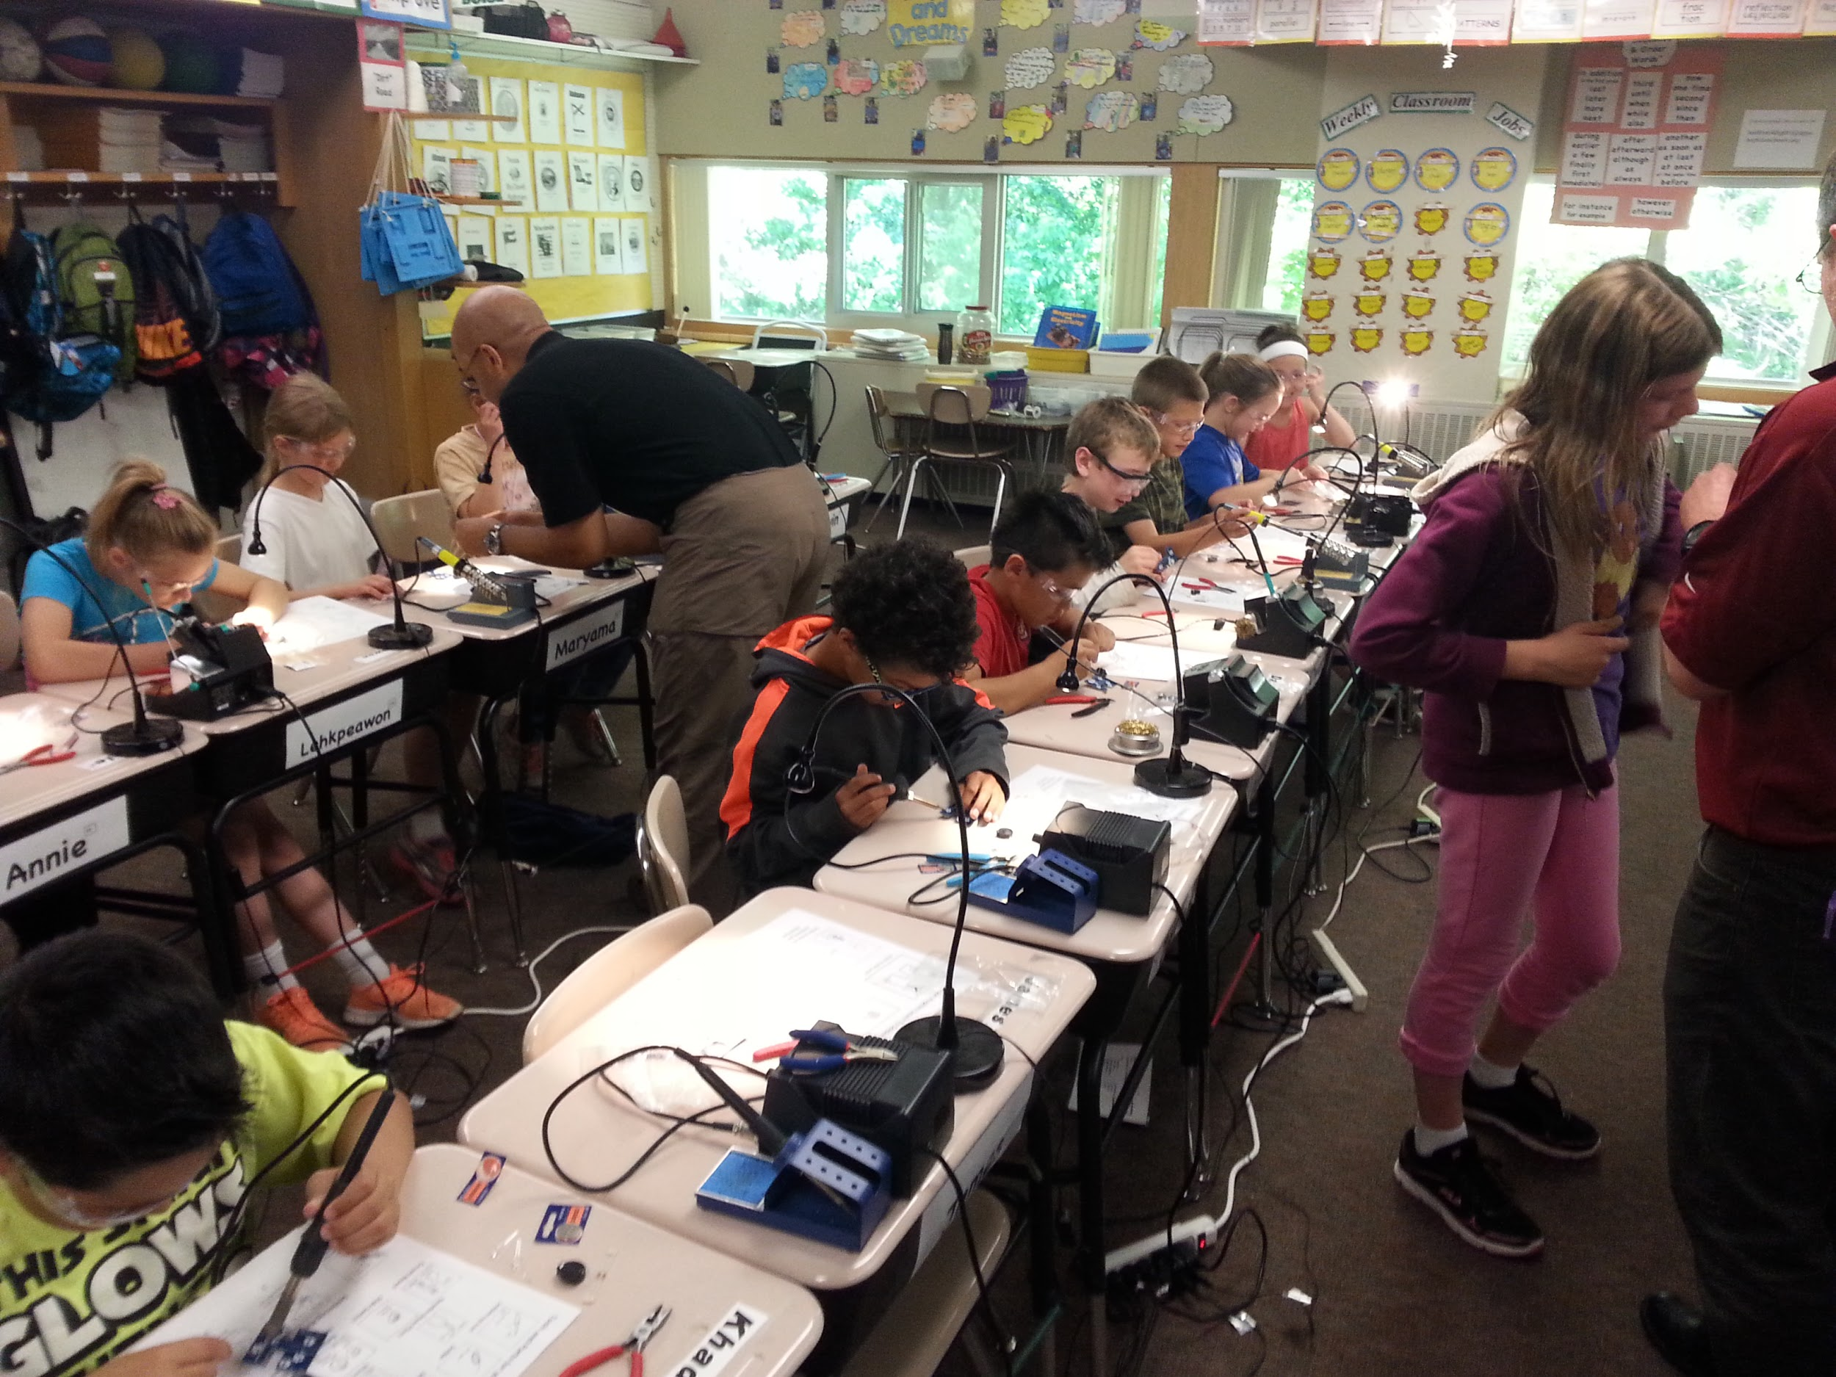
Notes:
Here are all 12 of the desks set up with soldering irons, lights, tools, safety glasses, and kits

Slide 16
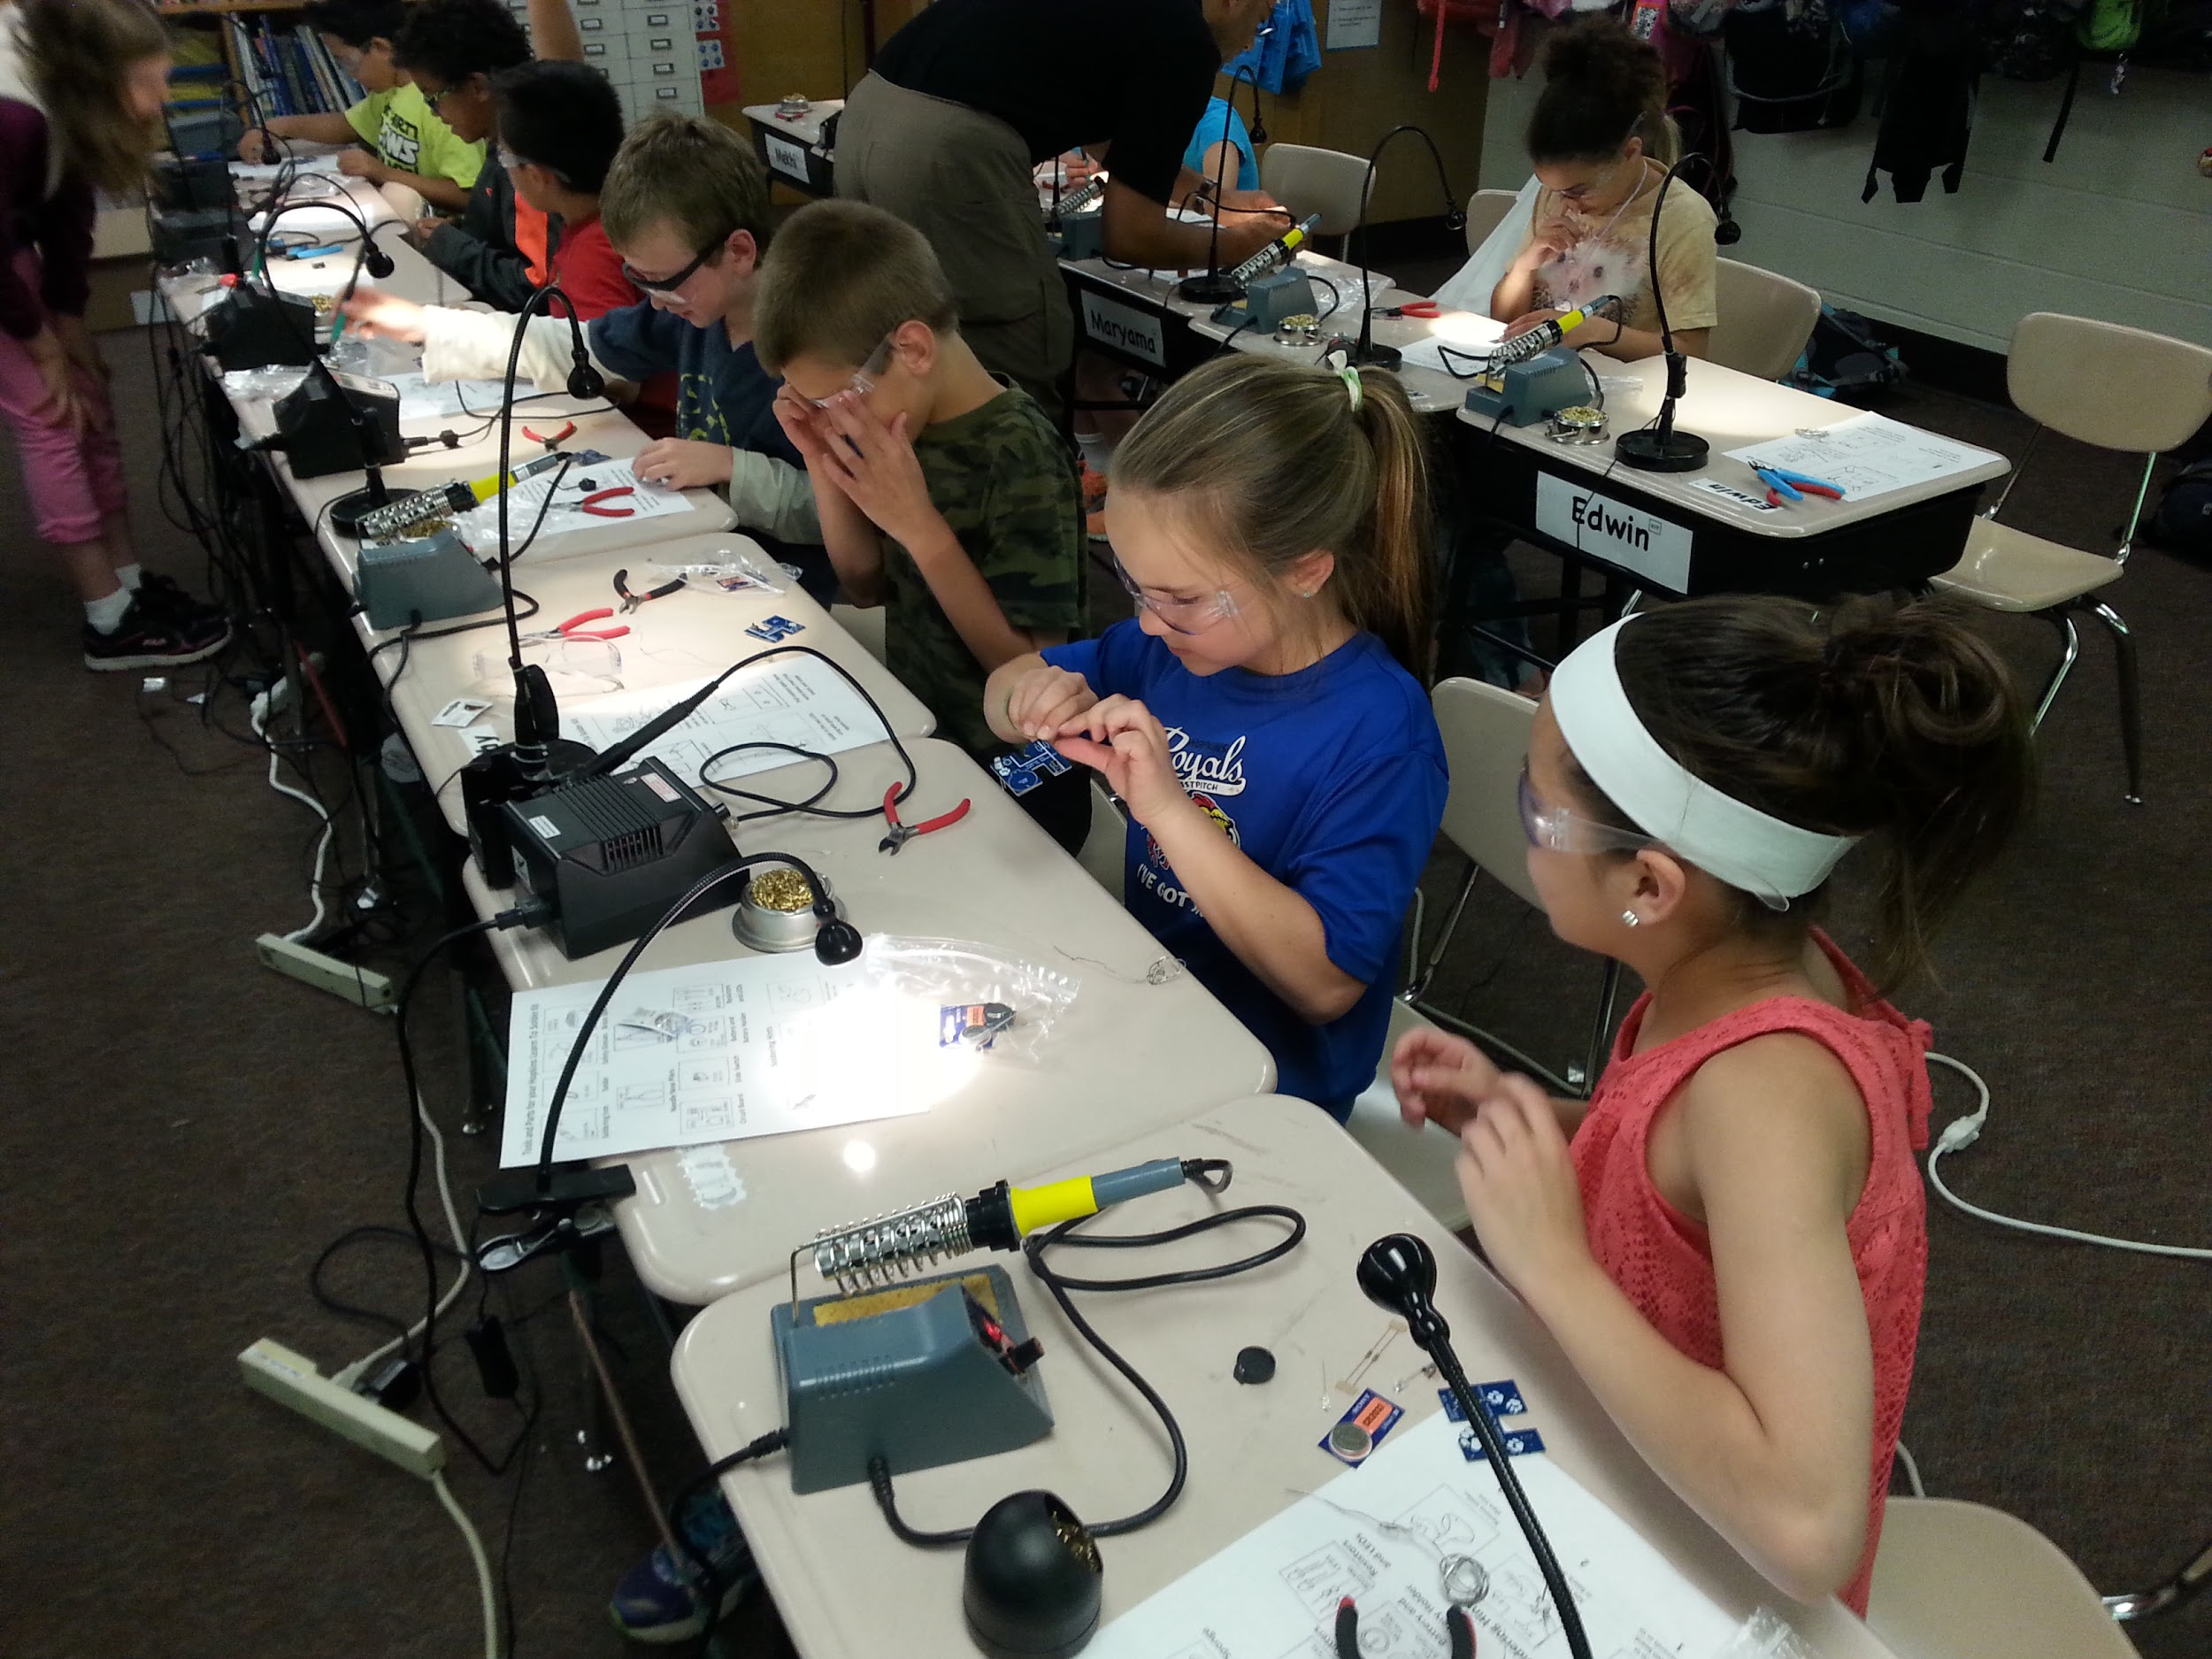
Notes:
The fourth graders are figuring out how to solder. Lots of them didn’t need any help at all.

Slide 17
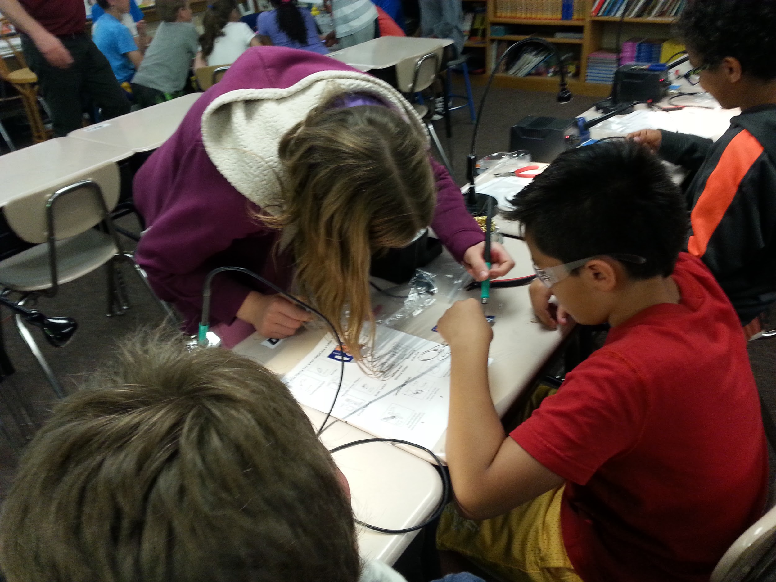
Notes:
Sometimes I had to help a student fix a mistake.

Slide 18
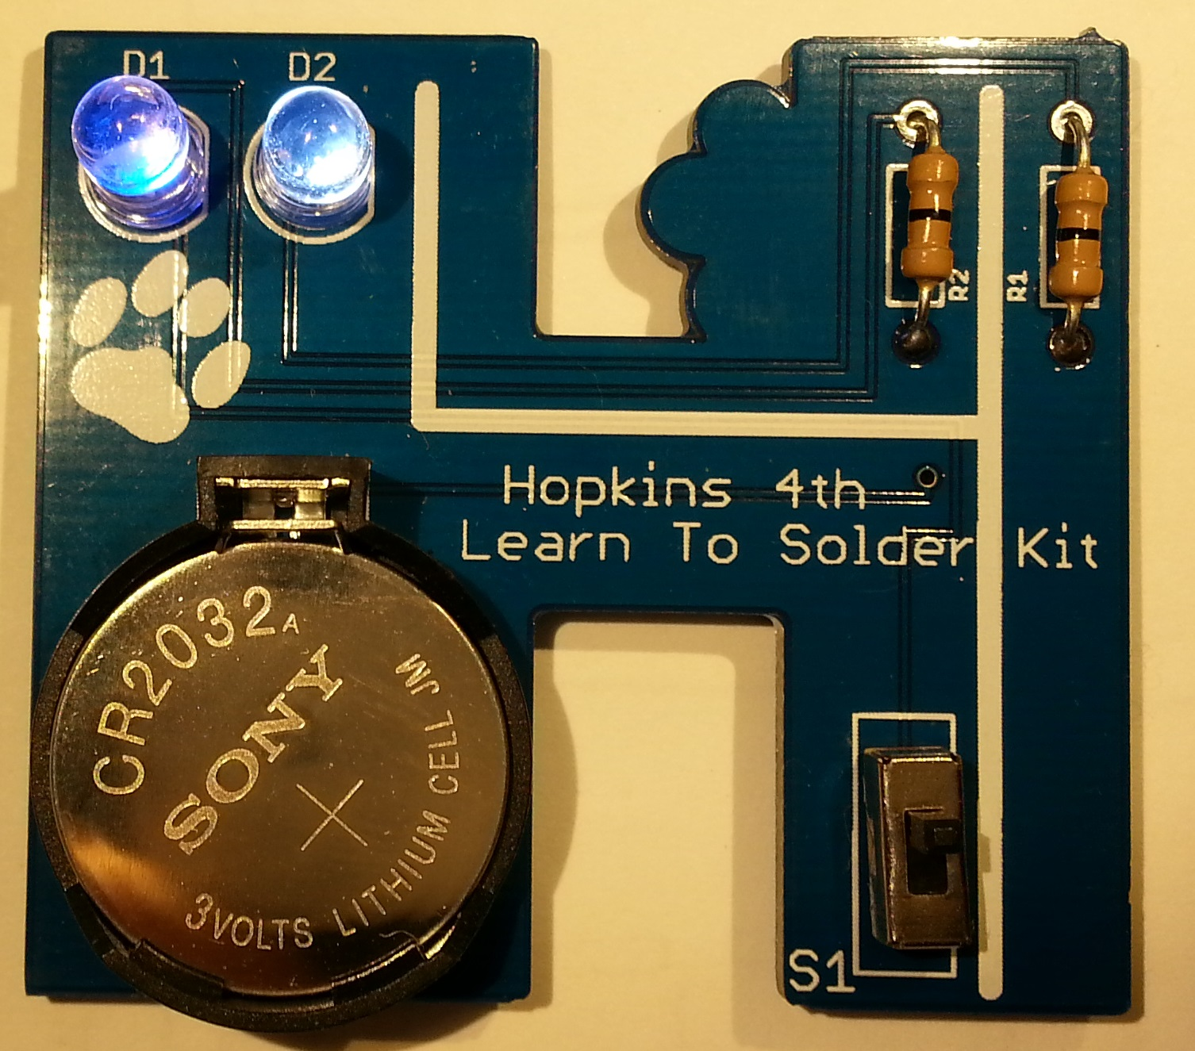
Finished Kit
Notes:
Here’s what the kit looks like when it is all done and working. The LEDs even blink!

Slide 19
STEM Day Lessons
Most students had no trouble soldering their kit and getting it to work
Difficulties: soldering and putting parts in board the correct way
Needed adults to re-work boards with problems
Extra parts and kits were needed too
Notes:
It was hard to get everyone done in time
Some students needed help putting parts in the right way
We also needed to help fix broken boards

Slide 20
Results
Academically challenged students felt sense of accomplishment and hope
Many students said they wanted to be engineers
Lots wanted to buy soldering irons and kits
I had fun helping my friends learn a skill
Notes:
Some of the students that were far behind the others academically easily put their kits together and even helped other students around them. They felt very proud that they could do something well, that the ‘smart kids’ had trouble with
It was really fun, and everybody had a good time
Next time we need to remember to bring band-aids and ointment for any burns that happen

Slide 21
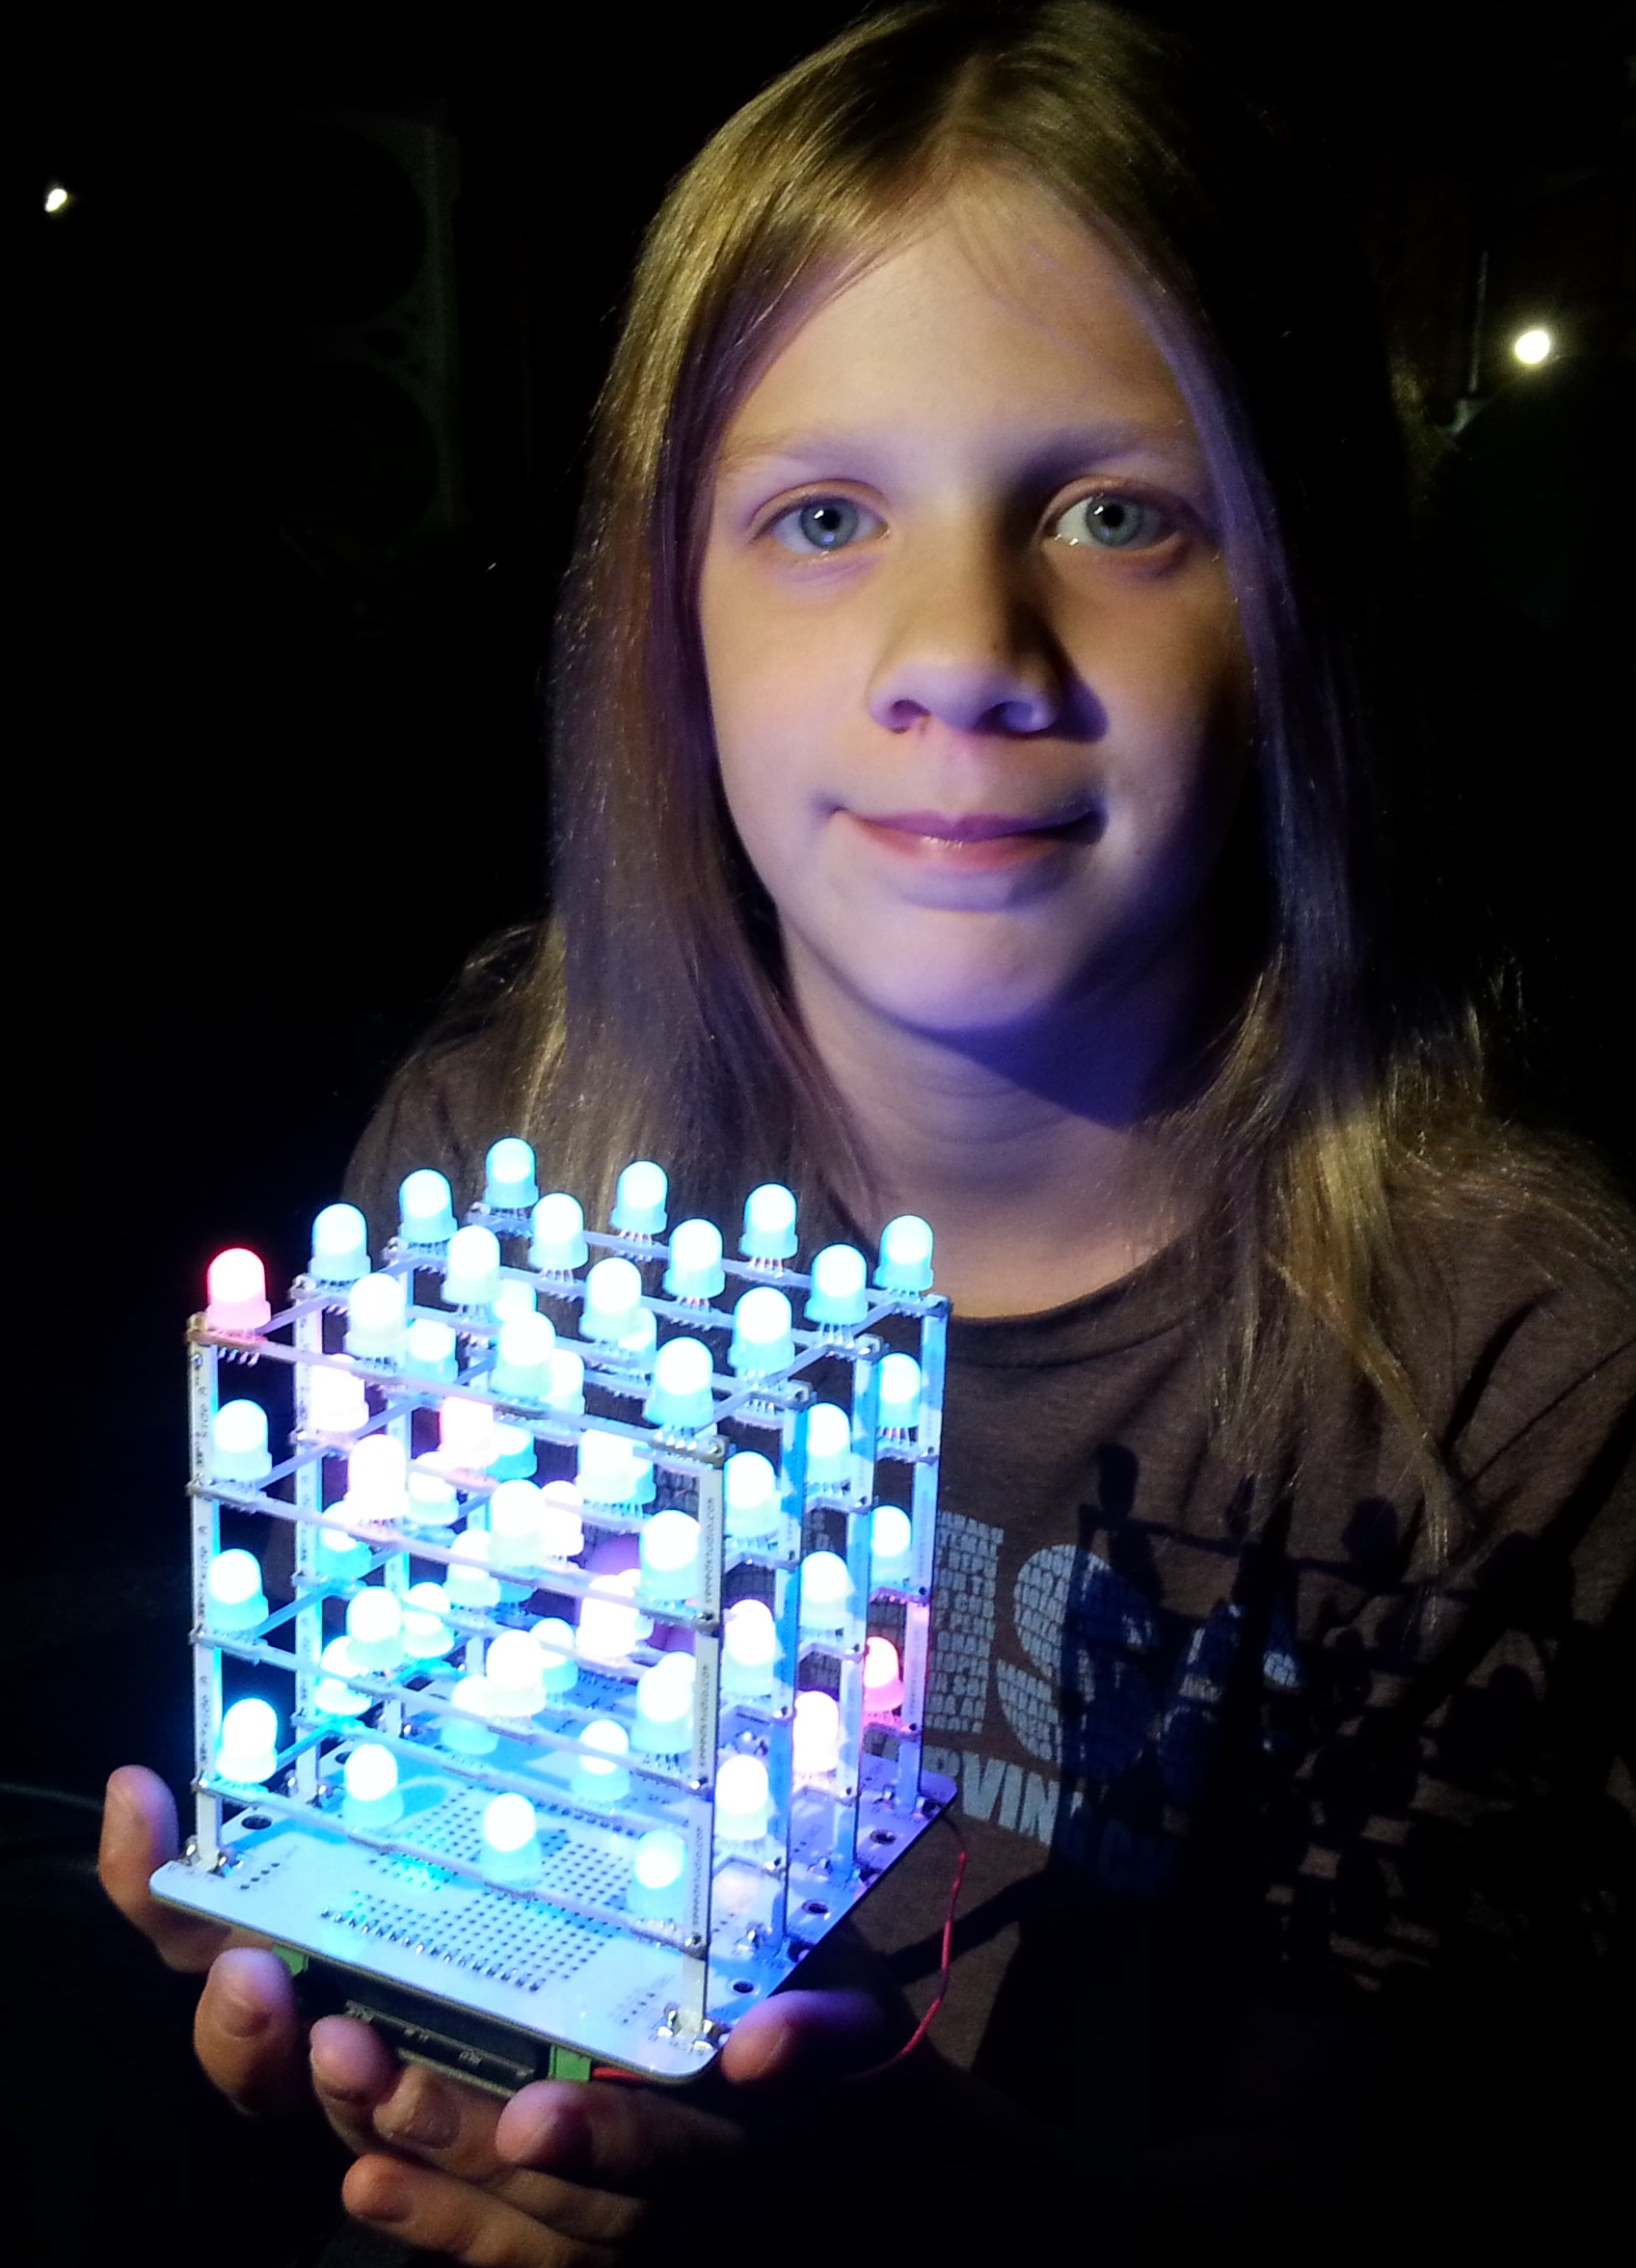
Questions?
Email:
deanna@schmalzhaus.com
brian@schmalzhaus.com
All files up on GitHub:
https://github.com/SchmalzHaus/LearnToSolder2015
Notes:
If you want to use this kit for your own class, let me know. All of the plans are up in my GitHub account, and you can e-mail me if you have any questions.

